Slide 1
H-1B Visa petitions
Xun Zhou

Slide 2
Problem area
Who?
What?
Where?
H-1B is an employment-based, non-immigrant visa category for temporary foreign workers in the United States.
This analysis is trying to predict the case status of the filed H1-B Visa petitions using various data such as employer name, job category, job title, location of job, filing year, and prevailing wage.

Slide 3
Data source
This dataset comes from Kaggle. (https://www.kaggle.com/nsharan/h-1b-visa)
It contains H-1B petition data from 2011 to 2016, with about 3 million records overall. The variables include case status, employer name, worksite coordinates, job title, prevailing wage, occupation code, and year of filing.
The sample is sufficiently numerous and various. However, it is highly imbalanced.

Slide 4
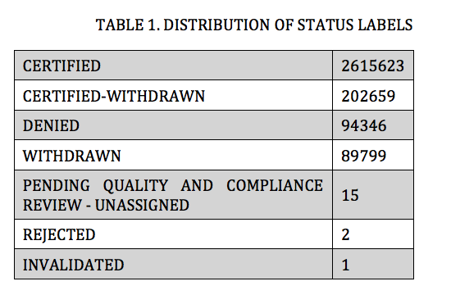
Data source

Slide 5
Data analysis
Prescriptive analysis
Decision Trees
Logistic Regression
Random Forest
Descriptive analysis
EDA
Data Cleaning
Data Transfor
Feature Engineering

Slide 6
Model application & uncertainty
uncertainties
Imbalanced Data
Hyperparameter Tuning
Model
Logistic Regression:
Dependent Variable: case status (certified/denied)
Independent Variables: employer name, job category, job title, worksite, filing year, and wage
Decision Trees & Random Forest:
Create a branch for every possible outcome based on the input values

Slide 7
Model evaluation
Model Evaluation
Accuracy = TP+TN/TP+FP+FN+TN
Precision Score = TP/TP+FP
Recall Score = TP/TP+FN
Confusion Matrix
FP = False Positive: Predicted Yes when Actual is No
FN = False Negative: Predicted No when Actual is Yes
TP = True Positive: Predicted Yes when Actual Yes
TN = True Negative: Predicted No when Actual No
The Higher
The Better

